Slide 1

Head and Shoulders Pattern Closed Target Prediction using back propagation
American University Of Science & Technology
Faculty Of Engineering Department of Mechatronics Engineering
Department of Information And Communication Technology
CCE 580/CSI 505: Neural Networks
Presented to Dr. Roger Achkar
Presented by:
Daniel Abou ElEzz 20210044 Azar Anthony Maalouf 20210181

Slide 2
Outline
Introduction
Background
Libraries used
Data Preparation
Head and shoulders Recognition
Parameters
Back Propagation
Experimental Results
Challenges and Future Work

Slide 3
Introduction
Prediction in Stock market.
Data science contribution.
A supervised learning technique used in artificial neural networks and It's called Backpropagation.
Head and Shoulders pattern.
Python.

Slide 4

Background
Neural Network in Stock market.
Head and shoulders pattern.
Review on Back propagation.

Slide 5

Libraries Used
The Python Libraries required for building the model:
Pandas
Plotly
Numpy
Scipy.stats
Yfinance
Sklearn

Slide 6
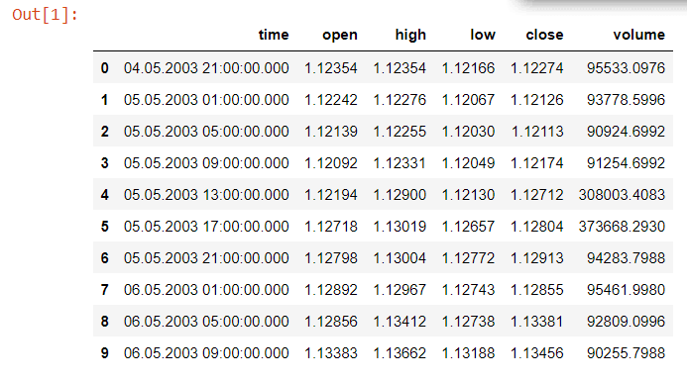
Data Preparation
The stock dataset is an important piece of information that provides valuable market conditions.
Here we used EURUSD from 5/5/2003 till 16/10/2022.

Slide 7
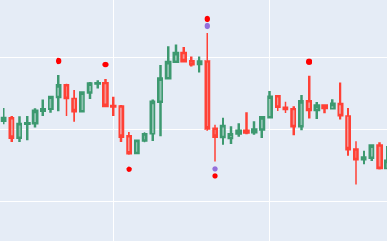
Head and shoulders Recognition
What’s a Head and Shoulders Pattern.
Pivot points.
Plotting.

Slide 8

Parameters
High, Low, Open, Close.
RSI (The Relative Strength Index).
EMAF (Fast Moving Average).
EMAS (Slow Moving Average).

Slide 9
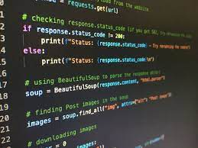
Back Propagation
Multilayer class:
Inputs
Forward Propagation.
Back Propagation.
Gradient descent, Sigmoid.
Error Average.
Training.

Slide 10
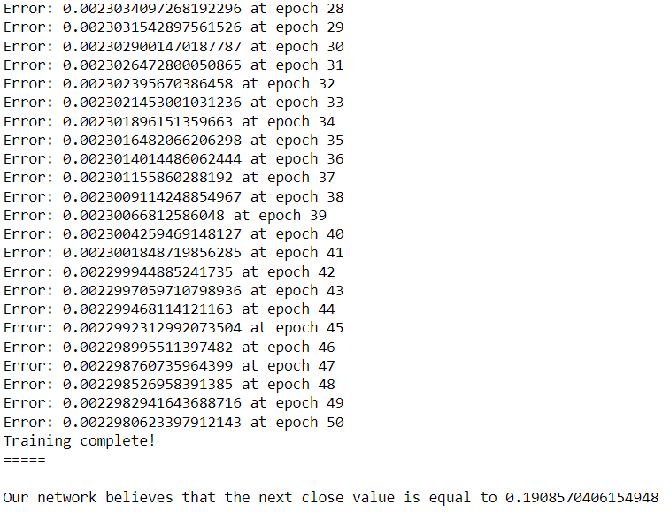
Experimental Results

Slide 11
Challenges & Future Work
Dataset Size.
Parameters.
Architectures.
Methods.

Slide 12
Thank you

